Slide 1
When and Why do We Use ADT₂₄ to Assess Thermal Risk?
Shasha Zhang
Process Hazard Evaluation, Chemical Process Development
Bristol-Myers Squibb (BMS)
P2SAC Fall 2022 Conference
Dec 14th -15th 2022

Slide 2
Brief Introduction of BMS PHE Group
Where we are
Drug Substance Operations and Supply
Process Hazard Evaluation
CPD
What we do
Hazard evaluation and testing for chemical process
Oversight of process safety testing for any production > 20 L
Guidance on safety program at partners and support for tech transfer
Dust and other testing associated with chemical hazards
Who we support
CPD
Lab & KL
Vendors
Discovery
EHS
CSO
Clinical Supply Operation
EM
External Manufacturing
Notes:
More content for our group

Slide 3
Stoessel Criticality
Stoessel Criticality is widely used by many pharmaceutical companies to evaluate thermal risk.
ADT₂₄, also known as TMR₂₄ and Td₂₄, is the temperature at which decomposition reaches its maximum rate in 24 hours under adiabatic condition
Stoessel Diagram
T_{ad}: Adiabatic Temperature Rise
MTSR : Maximum Temp Synthesis Reaction – usually T_{p} + T_{ad}
Acceptable risk
NOT allowed
Notes:
Clear definition of our operation range.
ADT24 -TD24 TMR24
Screening: equation. apply margine
How to calculate MTSR: 0% accumulation;
ADT24: equation – over estimate- report as ADT24 from DSC; AKTS; VSP; catalytical decom- isothermal DSC.
Safety margin: MTSR –heat of reaction 120%

Slide 4
When is ADT₂₄ needed to address thermal risk?
Risk = Probability x Severity
Severity – Screening will provide some ideas
  High T_{ad} Decomp > 200 ºC
  Medium 50 ºC < T_{ad} Decomp <200 ºC
  Low T_{ad} Decomp < 50 ºC
Probability – Based on decomposition kinetics
  Low TMR > 24 hrs
  Medium 8 hr > TMR < 24 hr
  High TMR < 8 hr
ADT₂₄ /TMR₂₄ as a probability indicator is triggered if the severity is medium to high
T_{ad}: Adiabatic Temperature Rise
TMR: Time to Maximum Rate
ADT₂₄/TMR₂₄ is the temperature at which decomposition reaches its maximum rate in 24 hours under adiabatic condition
Notes:
TMR represents critical time constant for effectiveness of safety measures.

Slide 5
When is ADT₂₄ needed to address thermal risk?
Risk = Probability x Severity
Severity – Screening will provide some ideas
  High T_{ad} Decomp > 200 ºC
  Medium 50 ºC < T_{ad} Decomp <200 ºC
  Low T_{ad} Decomp < 50 ºC
Probability – Based on decomposition kinetics
  Low TMR > 24 hrs
  Medium 8 hr > TMR < 24 hr
  High TMR < 8 hr
ADT₂₄ /TMR₂₄ as a probability indicator is triggered if the severity is medium to high
Practical procedure
Determine
energy
potential
< 100J/g
Energy from DSC?
>100J/g
Tad > 50°C
Process presents
no thermal risks
Assess probability of
triggering
Decomposition (ADT₂₄)
No need to waste resources!
Assess Criticality by
comparing
MTSR and ADT₂₄
Notes:
TMR represents critical time constant for effectiveness of safety measures.
Low risk low severity

Slide 6
When to Study ADT₂₄ at BMS?
Temp <=200 °C, heat > 200 J/g (Tad of 100 °C) ADT₂₄
Temp <=200 °C, heat < 100 J/g (Tad of 50 °C) No need
Onset =< 200 °C
Onset > 200 °C
Energetic /Explosive?
Heat > 200 J/g
100 J/g <= Heat <= 200 J/g
Heat < 100J/g
Kinetics / heat flow?
No
Yes
Fast
Slow
ADT₂₄
Low risk
Further study
Simple decision tree based on DSC data if no significant gas evolution
Notes:
50 C

Slide 7
Is the Study of ADT24 Needed?
For some marginal cases, thermogram needs to be reviewed to evaluate the necessity
BMS coupound
20 wt% DBDMH in DMF
Energy: 157 J/g; onset: 64°C
Energy: 107 J/g; Onset 124 °C
Vendor suggested a ADT₂₄ of 40 °C.
No need to study ADT₂₄
ADT₂₄ is determined to be 34°C.

Slide 8
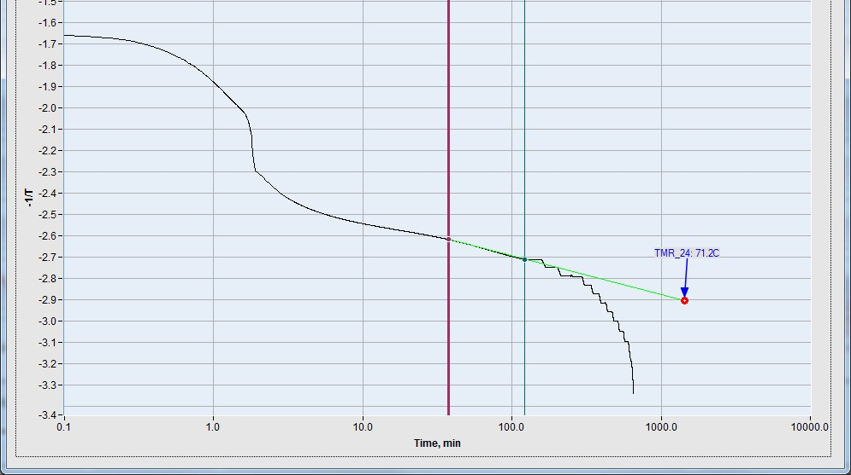
How to Determine ADT₂₄
Used by BMS
Kinetic approaches
  Isoconversion method: DSC/AKTS (Advanced Thermal Analysis Software)
  Adiabatic calorimetry
Run DSCs
Estimate Ea and A
Predict time to maximum rate
Extrapolate the beginning of the curve
Directly measure the kinetic curve

Slide 9
How to Determine ADT₂₄
Onset temperature as input
Usually overly conservative
Employed by some vendors
  Estimation approaches
  Traditional ‘safety Margin’ approach - ‘Distance rule’;
    T_{safe} = T_{onset} – X ºC
  Equation-based estimation
    Use onset temperature and instrument detection limit assuming Ea= 50 kJ/mol & zero-order kinetics
    Empirical equation for DSC:
DEKRA/Chilworth
Used by Legacy Celgene, but labelled as preliminary ADT₂₄
NOT BMS preferred approaches
May cause confusion
Stoessel, F., Thermal Safety of Chemical Processes
Notes:
Tsafe is differently from ADT24.
These are not method BMS is using!!!

Slide 10
Example 1: Production of an Early Intermediate
A production of 250 kg of intermediate was executed at vendor’s plant.
Desired reaction: RC1 data shows an adiabatic temperature rise of 41 °C.
DSC on distillation stream shows an exotherm of -312J/g from 131 °C. ADT₂₄ is 43 °C based on equation-based estimation by a vendor.
High risk
MAT =MTSR = Tp + Tad
= 67 °C > ADT₂₄ Criticality 5
Tb = 64.7°C
Distillation Temp of 45 °C > ADT₂₄
MAT (Maximum Achievable Temperature)
MTSR (Maximum Temperature of Synthetic Reaction)
Data collected by BMS Partner
Notes:
MSTR: worst case scenario

Slide 11
Example 1: Internal DSC/AKTS Study
Acceptable risk
A better method is needed to quantify ADT_{24.}
DSC on product shows an exotherm of -410 J/g with an onset of 116 °C.
MAT =MTSR = 67 °C.
ADT₂₄ is determined as 82 °C
Tb = 64.7°C
Tb< MTSR < ADT₂₄ Criticality 3
Distillation Temp of 45 °C < ADT₂₄
DSC/AKTS analysis shows ADT₂₄ is 82 °C.
Product is not isolated so ADT₂₄ is considered conservative

Slide 12
Example 1: Risk Mitigation Overview
An overly conservative estimate of ADT₂₄ may greatly affect assessment on safety.
The ADT₂₄ provided by vendors may lead to confusion – it is highly recommended to contact safety specialist for clarification.
High risk
Acceptable risk
Importance of ADT₂₄ study
MAT =MTSR = 67 °C.
ADT₂₄ is determined as 82 °C
Tb = 64.7°C
Tb< MTSR < ADT₂₄ Criticality 3
Distillation Temp of 45 °C < ADT₂₄
MAT =MTSR = 67 °C
ADT₂₄ is estimated to be 43 °C.
MTSR > ADT₂₄ Criticality 5
Distillation Temp of 45 °C > ADT₂₄
Notes:
Green bucket optional

Slide 13
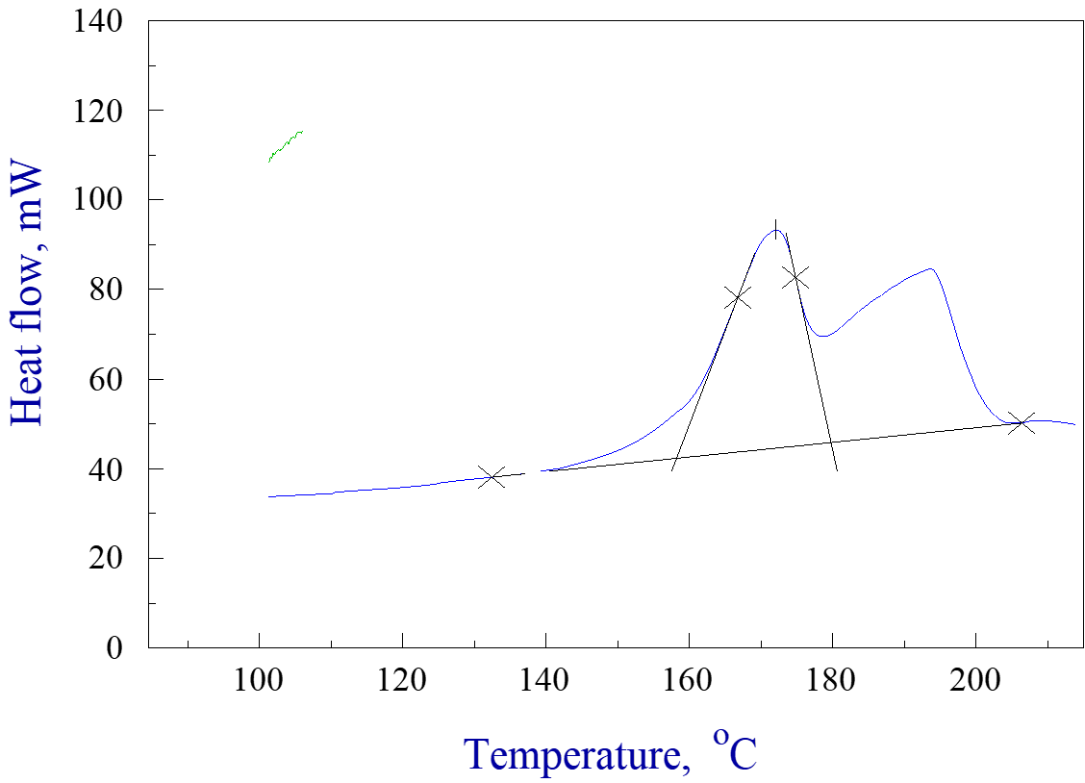
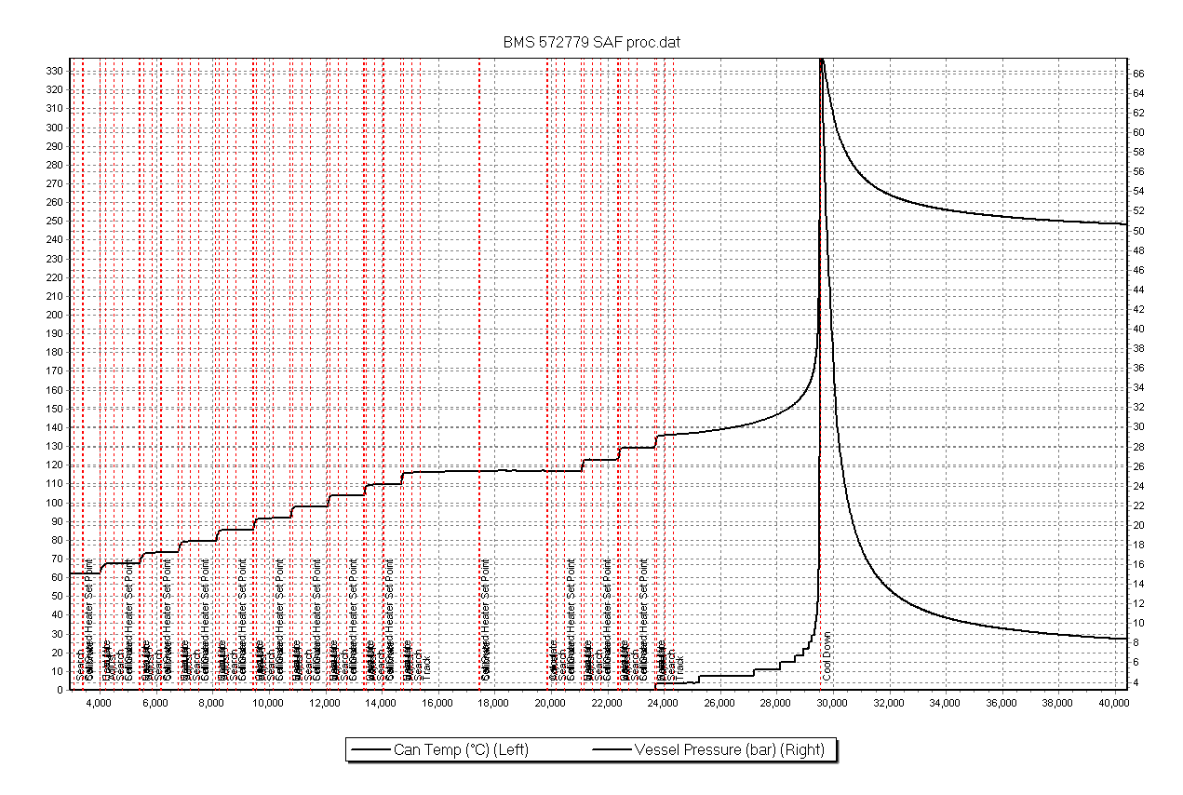
Example 2: Thermal Stability of Rxn Mixture
An early intermediate was produced on a commercial scale.
The condensation is endothermic with a Tad of -12 °C.
C80 data of reaction mixture shows an exotherm with an enthalpy of -420 J/g and an onset of 135 °C.
Other ARSST and ARC tests confirmed that the exotherm poses a safety concern.
Heating rate: 0.5 K/min
Sample mass: 479mg
Notes:
How long does the reaction take?

Slide 14

Example 2: Summary of ADT₂₄ study
 | Sample used | Phi | Onset Temp | ADT8 | ADT24
ARSST | 10 mL | ~1.05 | 140 °C | 124 | 115
C80+AKTS | 2 mL | - | 136 °C | 118 | 104
Phi Tec II | 50 mL | 1.14 | 135 °C | 118 | 109
ARC (BMS) | 5 mL | 1.27 | 123 °C | 117 | 110
ARC (vendor) | 3 mL | 1.91 | 131 °C | 115 | 104
If ’50 K safety margin’ or ‘equation-based estimation’ approach is used, the process temp will probably be set around 76 °C, which is too low for the reaction to run.
Consistent results of ADT₂₄ were obtained from different kinetic methods.
Combining with reaction calorimetry data, the criticality index of the process is rated as “2” in Stoessel system.
The process was safely implemented at commercial scale.

Slide 15
Example 3: ADT₂₄ Study of Tetrahydroxydiboron
Tetrahydroxydiboron has been used in many BMS projects.
ADT₂₄ study is important due to its fast decomposition rate and large energy (~1600J/g)
Onset temperature is in the range of 95 -125 ºC depending on experimental condition.
ADT₂₄ is in a narrower range of 70-82 ºC, indicating ADT₂₄ is a more reliable parameter to set the maximum operation temperature limit.
Estimation of ADT₂₄ using onset temperature may introduce larger variability.
DARC data collected by D. Vanyo

Slide 16
Summary
When to study ADT₂₄?
ADT₂₄ as a probability indicator is triggered if the severity of decomposition is medium to high.
  Simplified answer: an exotherm energy > 100 J/g below 200 °C.
Why to use ADT₂₄?
Using an overly conservative estimate of ADT₂₄ may greatly affect the assessment on safety.
  Simple screening test with distant rule or equation-based estimation may be used by BMS vendors.
A real kinetic study of ADT₂₄ delivers reasonable safety margin.
    Kinetic approaches are preferred by BMS
    Kinetic approaches provide realistic ADT₂₄, and have been demonstrated by many portfolio projects at BMS.
ADT₂₄ is a more reliable parameter to set maximum operation temperature.
  Estimation of ADT₂₄ using onset temperature may introduce larger variability.

Slide 17
Acknowledgement
Simon Leung, Tao Chen, Douglas Mcleod, Mark Lindrud, Junying Fan, Buck Holloway, Melanie Miller, Paul Fernandez, Nicolas Cuniere, Fransisco Gonzalez Bobes, Chris Sfouggatakis, Dimitri Skliar, Subha Mukherjee, Bahar Inankur, Patrick Sipple, Ketleine Georges, Chris Tickner, Dale Vanyo, Alan Fritz, Steven Chan
BMS partner’s safety group and project team for safety study.

